Slide 1
TESTING THE SPATIAL ECOMONICS THEORY

Slide 2

HELLO!
This is a presentation of my IBM data science capstone project

Slide 3
Economic theory suggests that businesses ought to locate themselves near their competitors in order to carve out a bigger segment of the geographic market
But is that true in real-world contexts?

Slide 4
WHO CARES?
The SCHOLARLY question
Academics might care because it would help explain the behavior of businesses, how businesses make decisions, and what factors influence their decision-making
The BUSINESS question
Businesses, business advisors, and trade groups might all want to know how to choose the best geographic location for a business. Should they locate close to competitors to carve out the biggest pie slice, or should they move away from competitors to distinguish themselves?

Slide 5
1.
TWO STATES AND CITIES
Start with Wisconsin and Minnesota

Slide 6
Pull down zip code and location data
Get data from public API
Download as json
Convert and clean
Then plot zip code locations for both states

Slide 7
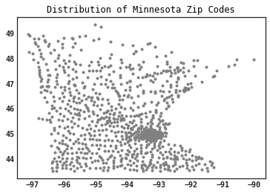
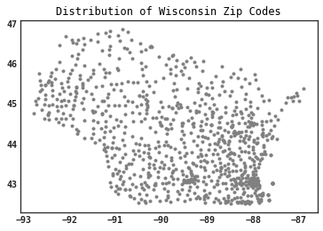
Plot zip codes by latitude and longitude and urban dense areas are apparent

Slide 8
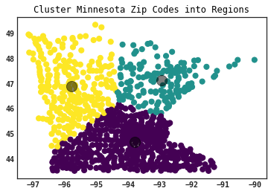
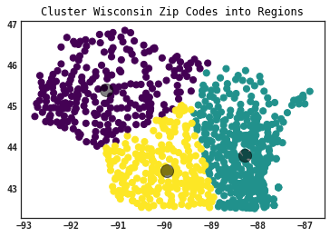
Cluster analysis places bulk of zip codes into one urban cluster

Slide 9
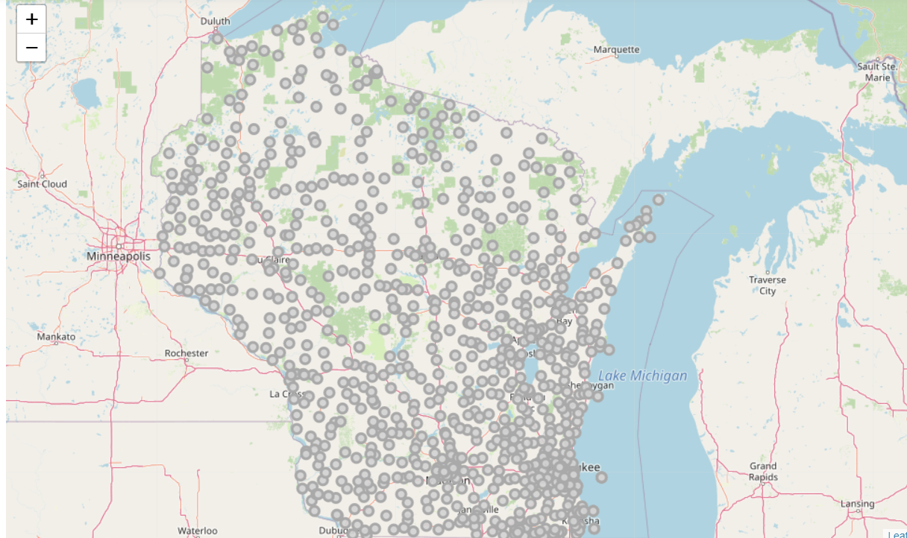
Map of Wisconsin shows concentration of zip codes in Milwaukee and north and south of city

Slide 10
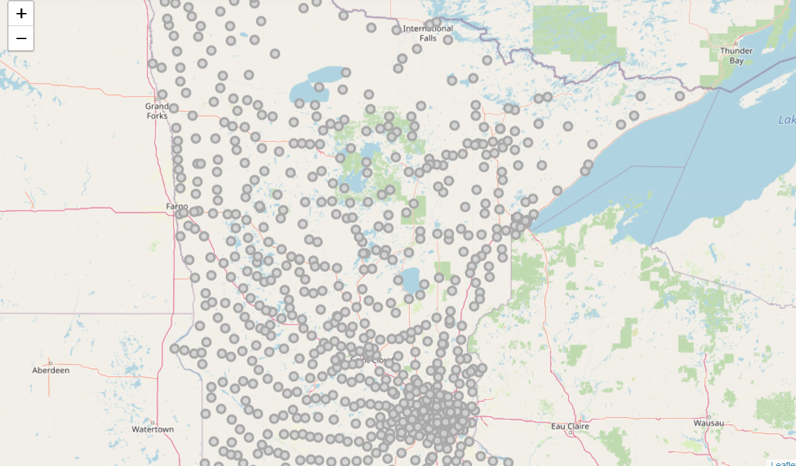
Map of Minnesota shows concentration of zip codes in Minneapolis/Saint Paul and radiating out in all directions

Slide 11
TWO CITIES AND TWO BUSINESS TYPES
Laundries
Tend to be near residential areas, often in lower income areas
Banks
Tend to be near other businesses and shopping areas, more often in higher income areas

Slide 12
DATA
Locations
Zip codes and latitudes and longitudes
Folium
Package for Python for creating maps
Foursquare
Information on business, their names, type, and location

Slide 13
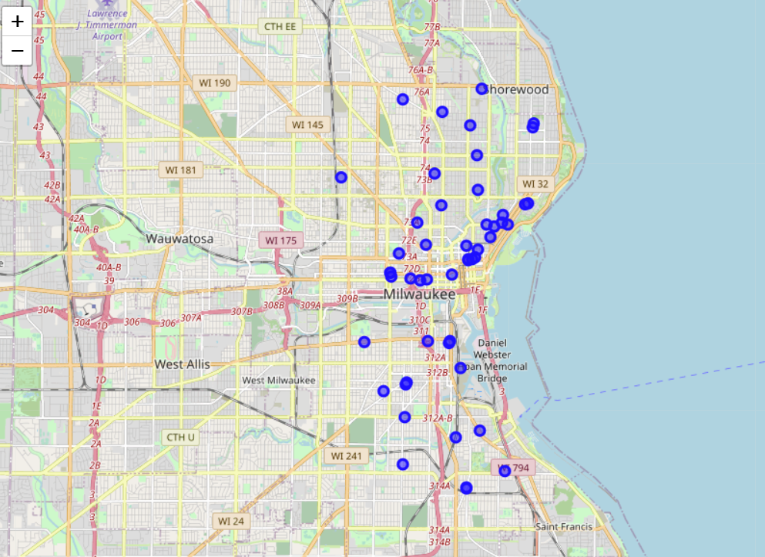
Laundries in Milwaukee:
Spread out north and south, still centered on the city center

Slide 14
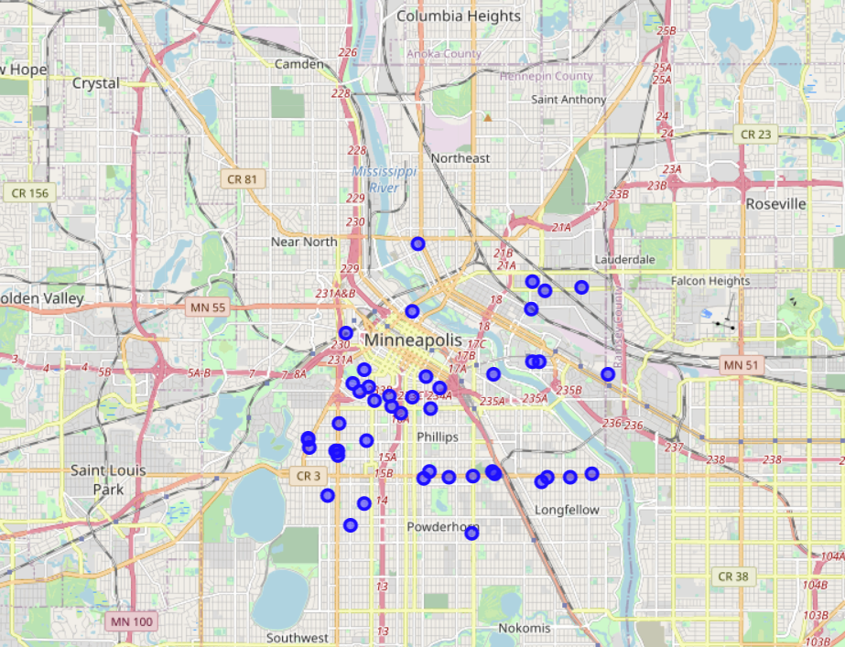
Laundries in Minneapolis/Saint Paul:
Spread out more radially from center, but still centered on city center

Slide 15
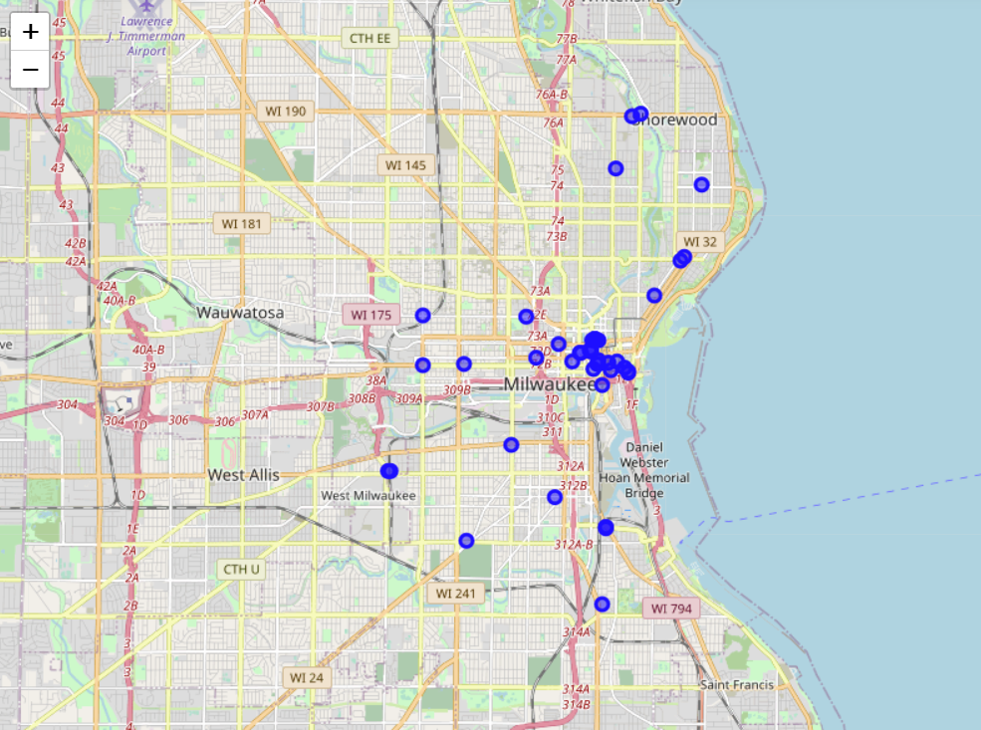
Banks in Milwaukee:
Clustered around city center, some spread north, west, and south

Slide 16
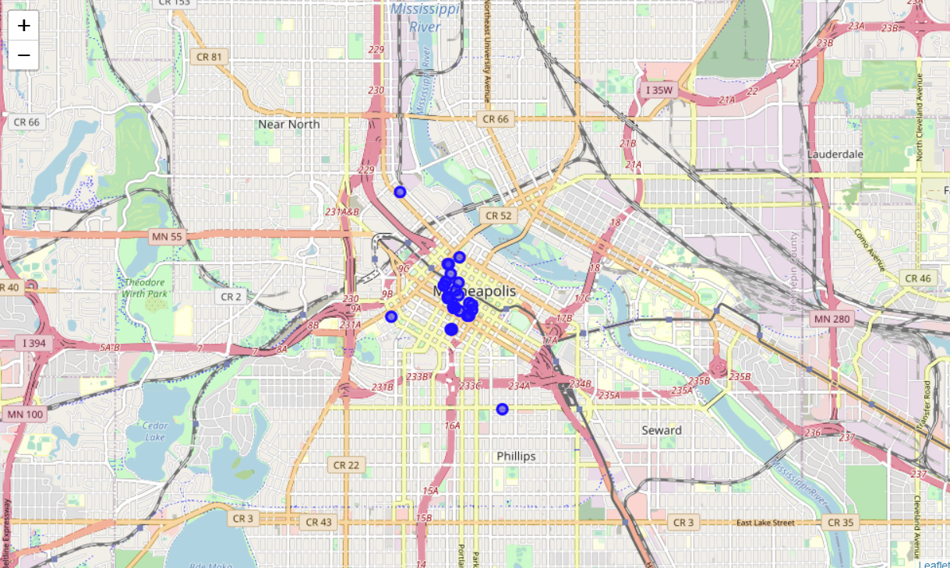
Banks in Minneapolis/Saint Paul:
Very little spread, tight cluster on city center

Slide 17
Calculated geographic center of each kind of business in each city
Then calculated the geographic distance of each business in each city to the center

Slide 18
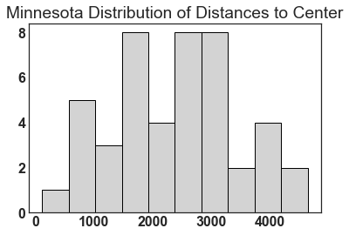
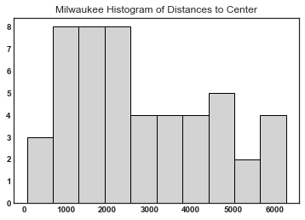
Laundry histograms show the central tendency and dispersion of distances

Slide 19
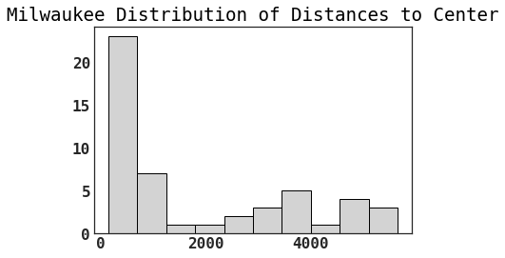
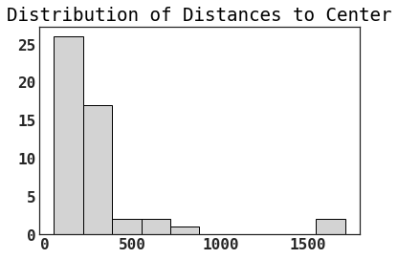
Bank histograms show the central tendency and dispersion of distances

Slide 20
The four histograms suggest visible differences in central tendency and dispersion
Looks like differences between businesses and between cities

Slide 21
MEASURES
Calculated five measures from each set of business/center distances for each city
Mean
Median
Standard deviation
Median absolute deviation
Inter-quartile range

Slide 22
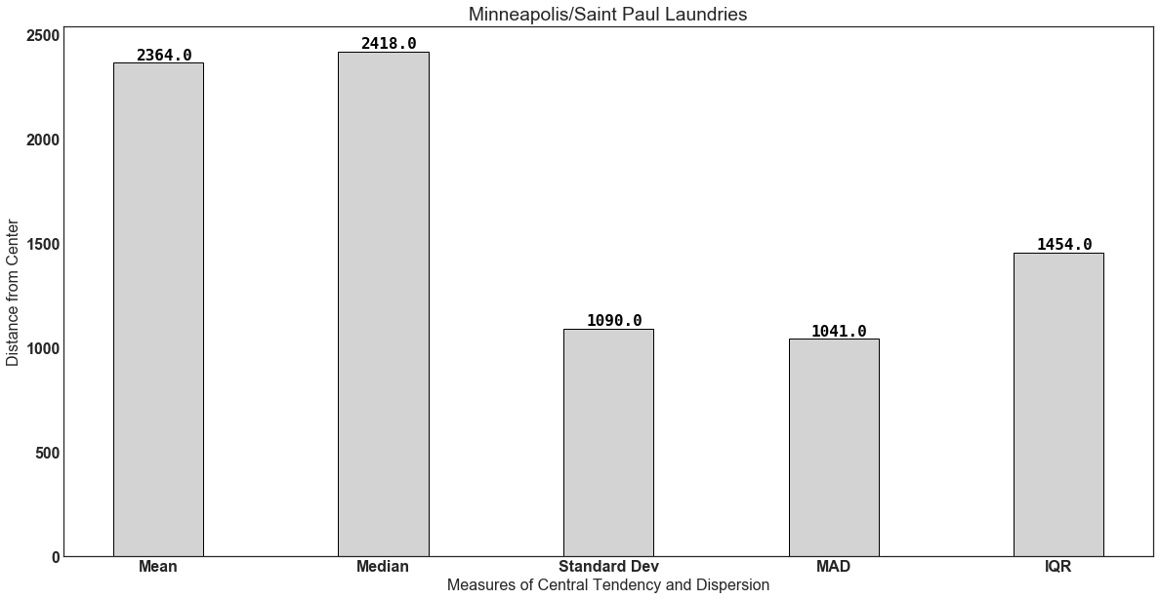
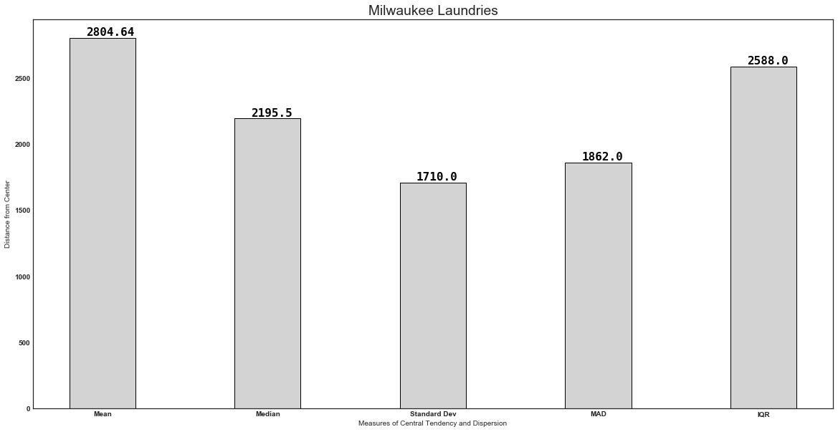
LAUNDRY MEASURES
Looks like some similarities and some differences

Slide 23
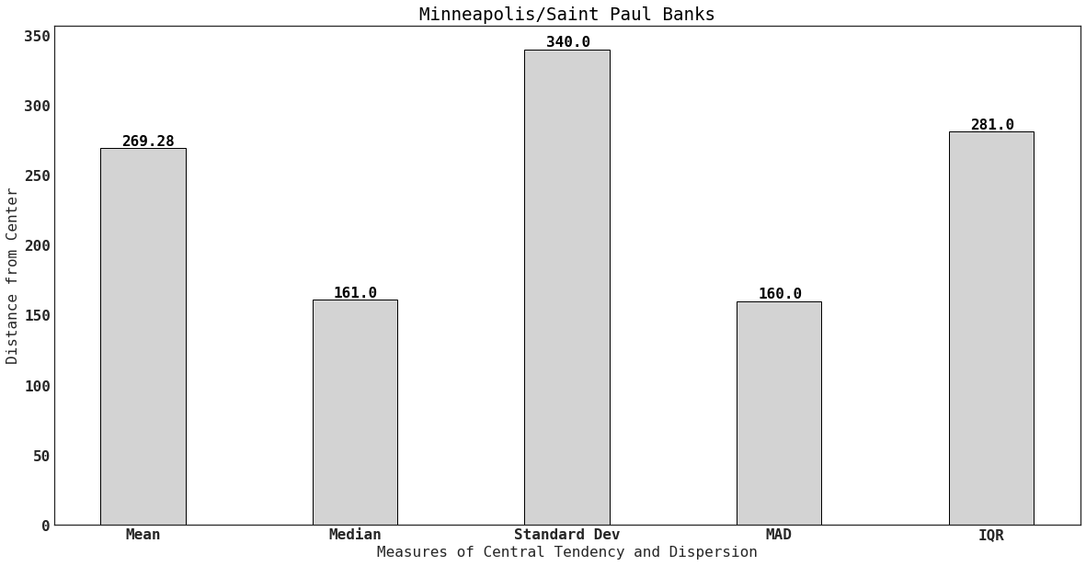
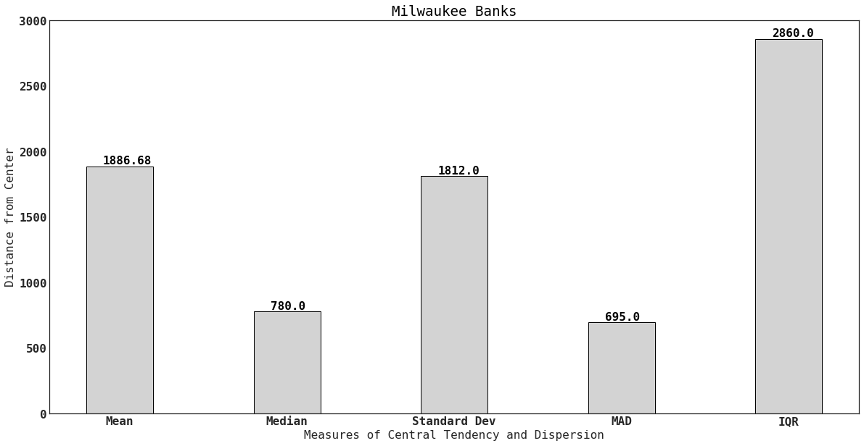
BANK MEASURES
Some greater differences can be seen here

Slide 24
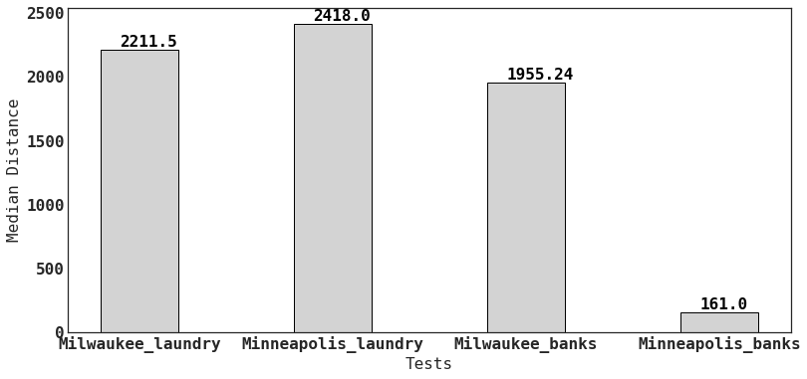
Median Distance: clear differences here

Slide 25
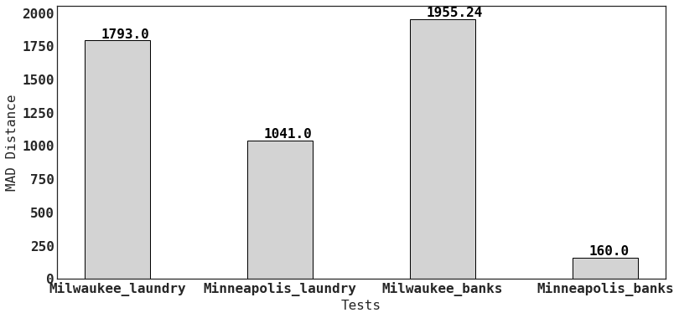
Median Absolute Deviation: again some large differences

Slide 26
What does this mean?
Minneapolis/Saint Paul banks are most tightly clustered
Overall, Minneapolis businesses show smaller less dispersed distances
All businesses centered on city center itself

Slide 27
So what about the theory?
Analysis lends support to the theory since businesses do tend to cluster right around the city center.
But how tightly they cluster varies considerably by city and also by business type.

Slide 28
Next steps:
Expand the analysis to include more types of business and more cities.
When choosing a location for your new business, pick some place close, but not too close, to your competitors.

